Slide 1
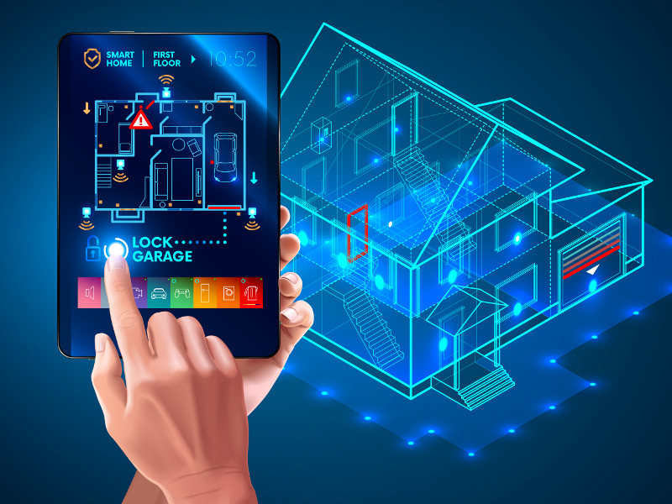
SMART HOME AUTOMATION SYSTEM

Slide 2

GROUP – Soul Cynics
AA1683 | K.S.Winodahewa | Kaushikawi@sltc.ac.lk | 0773288579
AA1679 | E.M.M.S.Ekanayaka. | mihisankasa@sltc.ac.lk | 0779410681
AA1874 | Nayani Nawarathne . | nayanin@sltc.ac.lk | 0717925934
AA1822 | M.M.R.Y.M.B Amarathunga | rashmia@sltc.ac.lk | 0702198085
AA1840 | Nethmi Liyanage | yashodal@sltc.ac.lk | 0766379699

Slide 3
Introduction
Home automation can quickly bring the future in to our homes by incorporating security, climate, and household gadgets and transforms our regular home into a futuristic smart home. These smart home systems can be used for simple or elaborate tasks by integrating devices and gadgets inside and outside of your home.
This project presents a possible solutions whereby the user controls devices into smart automated devices or systems.
We are going to introduce some new features like motion detected light , motion detected roller door, security system, temperature and automation light which controlled by mobile application.

Slide 4
Goal
The main goal is implementing a home automation system which has several smart function to improve quality of life and convenience in the home.

Slide 5
Objective
Our main objective is implement low cost , reliable and scalable home automation system which include motion detected light, motion detected roller door , smart security system , temperature controller, and smart lights which are connected with WIFI through the internet.

Slide 6

Tools and components
Hardware:
RASPBERY PI 3 MODEL B+
Arduino UNO board
Ultrasonic sensors
Generic CPVKHEDC Breadboard
Servo Motors
Jumper wires
Buzzer
Resistor 330 ohm
IR sensors
LED bulbs

Slide 7
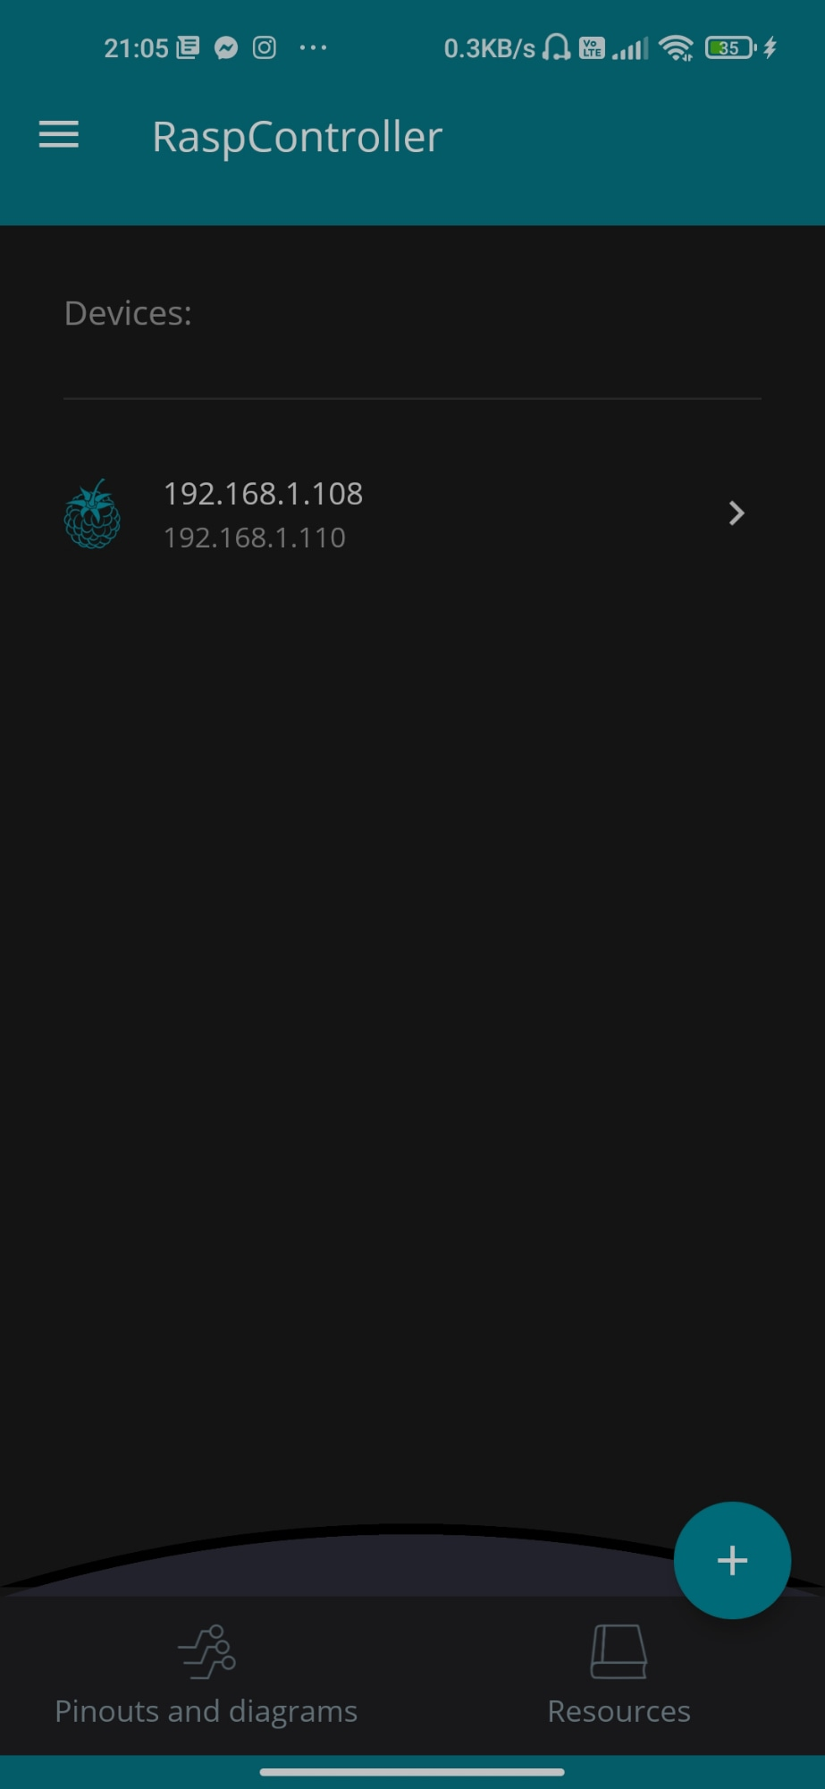
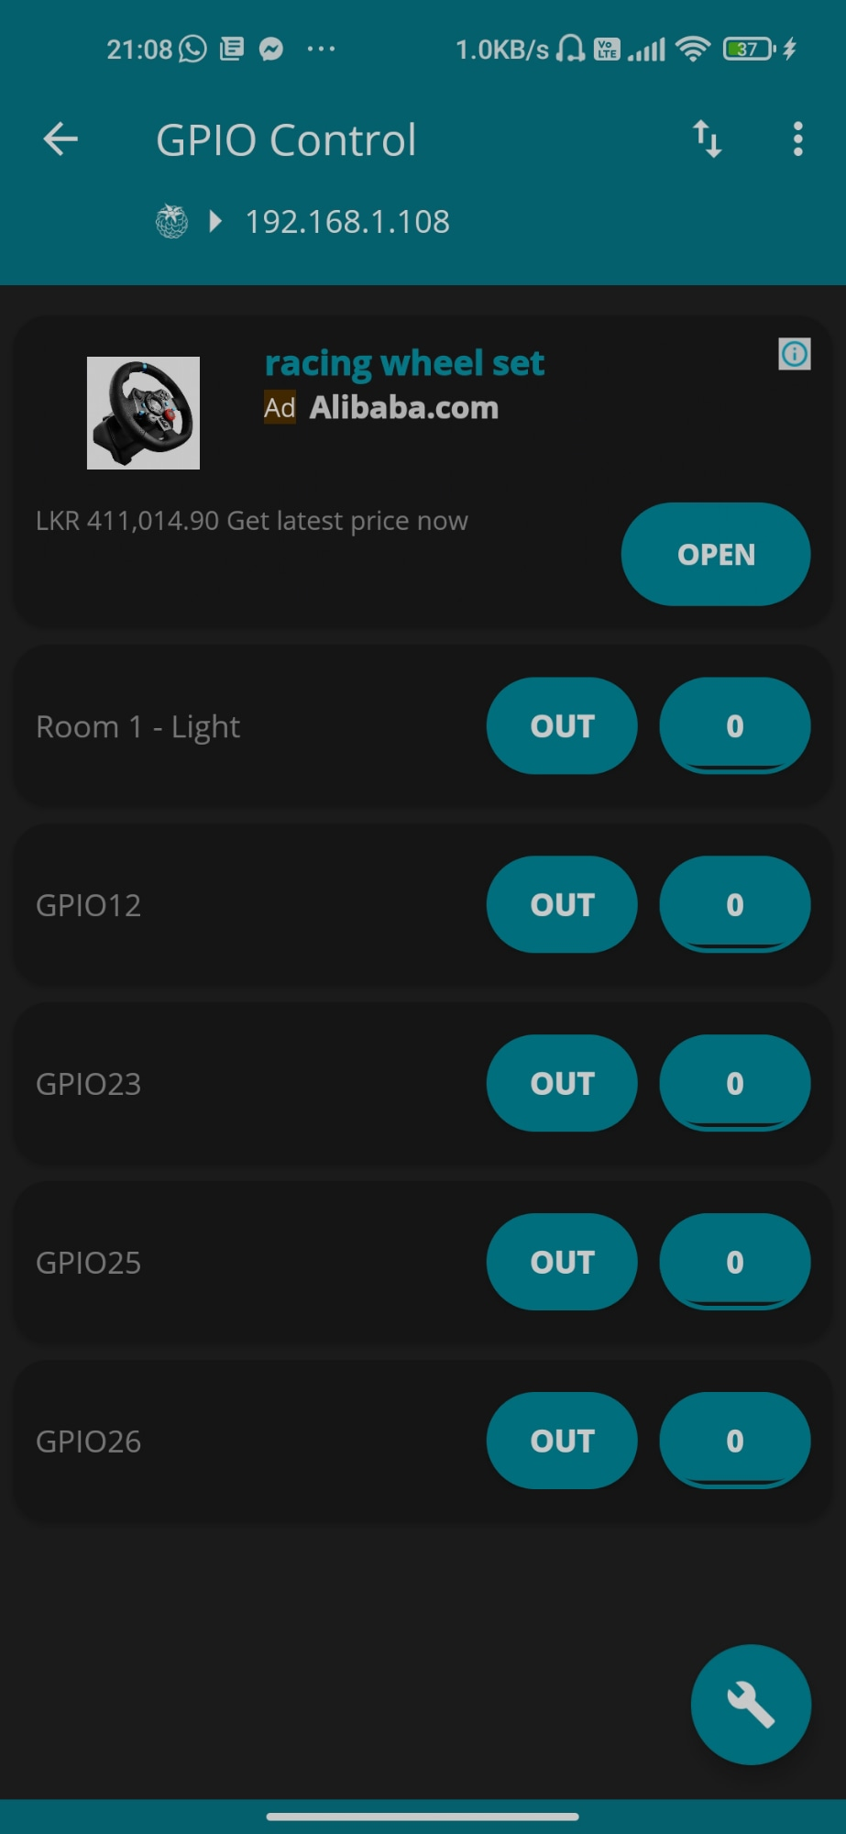

Software:
All the hardware components code with Arduino studio.
Raspberry Pi control with Raspcontroller app.
Home automation system control with mobile application.

Slide 8
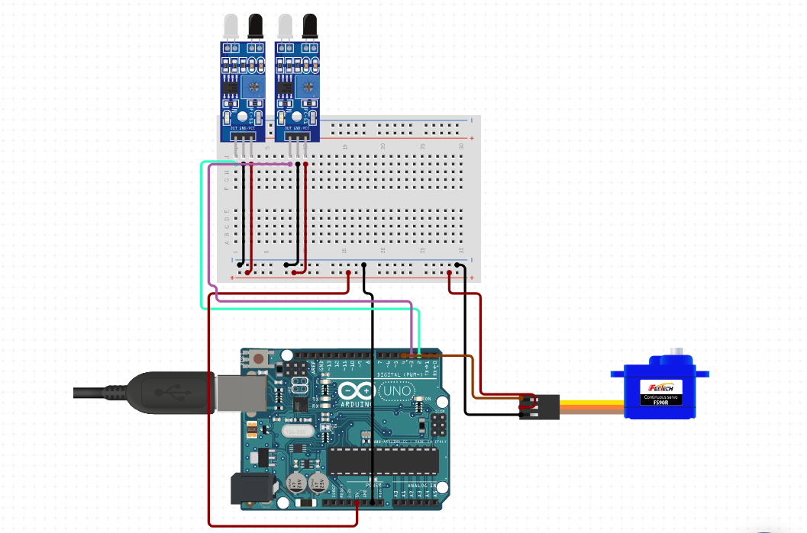
System Diagram for Automated Gate

Slide 9
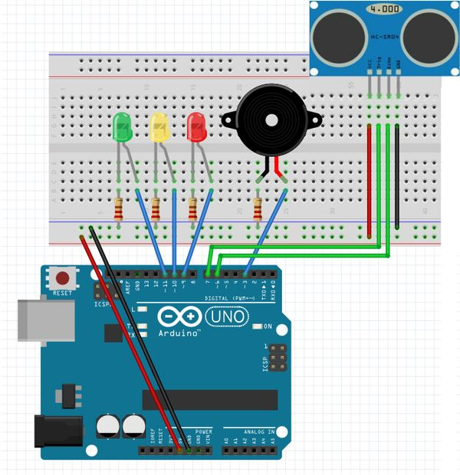
System Diagram for Automated Security System.

Slide 10




Functions
Motion detected light
Light
Security Systems
Motion detected roller door

Slide 11
Budget Plan
Tool | Quantity | Price (LKR)
IR sensors | 2 × 230.00 | 460.00
Ultrasonic sensors | 2 × 450.00 | 900.00
RASPBERY PI 3 MODEL B+ | 1 × 11,700.00 | 11,700.00
Arduino UNO board | 1× 4690.00 | 4690.00
Generic CPVKHEDC Breadboard | 1 × 290.00 | 580.00
Servo Motors | 1 × 530.00 | 530.00
Jumper wires 40ps | 3 × 230.00 | 800.00
Buzzer | 1 × 125.00 | 125.00
Resistor 330 ohm | 4 × 1.00 | 4.00
LED Bulbs | 10 | 60.00
Bristle Board | 2 × 40 | 160.00
Glue gun sticks | 3 × 50.00 | 150.00
Wood, Nails 50

Slide 12
Further improvements
Arduino-based device control using Bluetooth on Smartphone projects can be enhanced to control the speed of the fan or volume of the buzzer etc.
Home automation and devices control can be done using the internet of Things - IoT technology.
We can replace Bluetooth by a GSM modem so that we can achieve device controlling sending SMS using the HSM modem.

Slide 13
Pros and cons of Home Automation system
Pros:
Pros and Cons Of the Home Automation System
Easier to Lock and Unlock the Doors
Save Energy with Smart Energy Consumption
Ease of Using smart home technology
Customize as Per Your Convenience
Smart home technologies are really Smart
Insurance benefits

Slide 14
Pros and cons of Home Automation system
Cons:
Pros and Cons Of the Home Automation System
cost
Dependency on Internet
Dependency on Professionals
Security issues
Maintenance and repair issues
Video surveillance

Slide 15
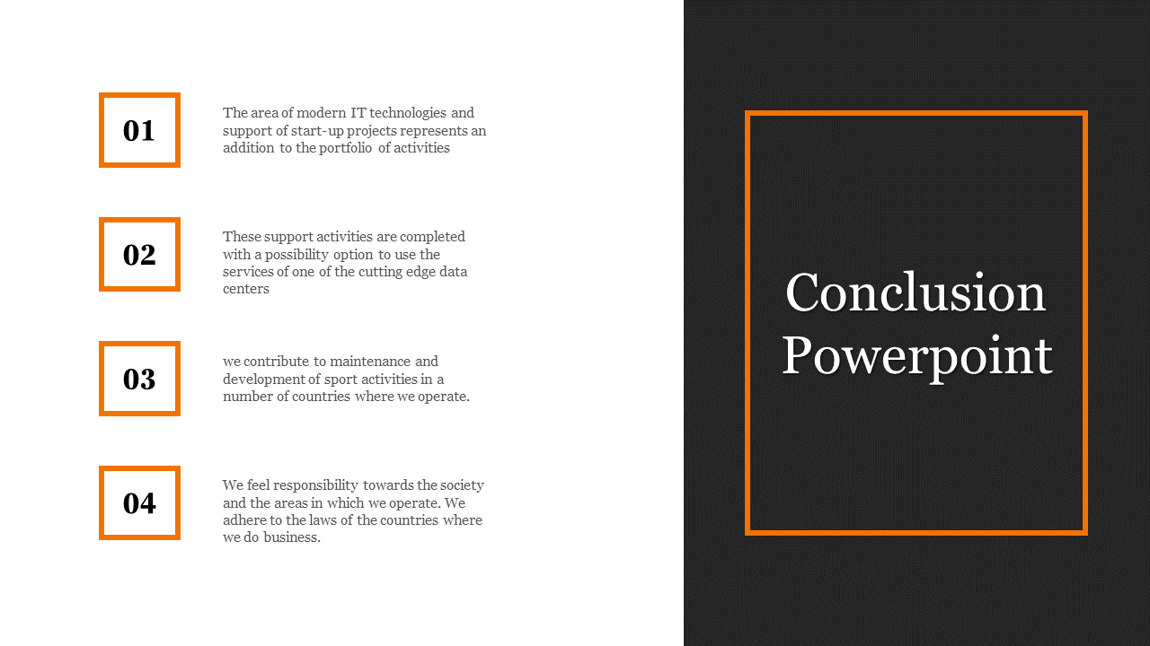
Conclusion
The home automation system has been experimentally proven to work satisfactorily by connecting sample applications to it and the appliances work satisfactorily by connecting sample appliances that were successfully controlled from a wireless mobile device.
We learned many skills such as soldering wiring the circuit and other tools that we use for this project and were able to work together as a team during this project.
The Bluetooth client was successfully tested on a multitude of different mobile phones from different manufacturers, thus proving its portability and wide compatibility. Thus a low-cost automation system was successfully designed, implemented, and tested.

Slide 16
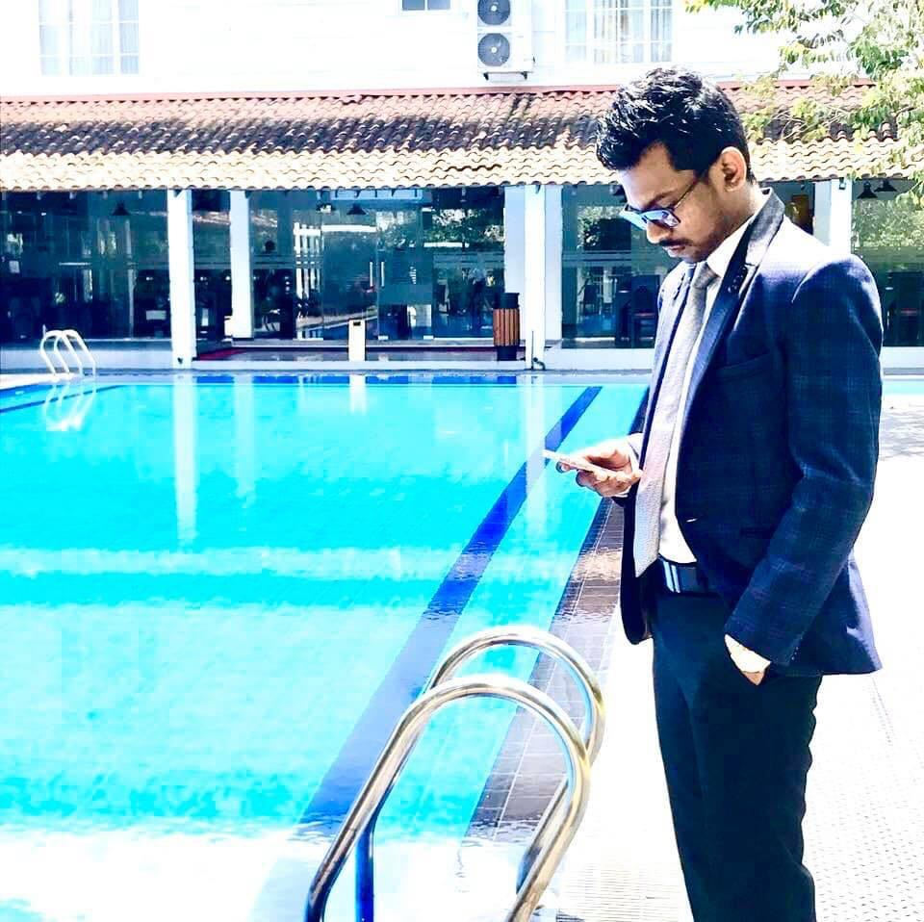




Team Presented
Kaushika Shehan Winodahewa.
Mihisanka Sadudeeptha Ekanayaka.
Rashmi Yashodha Amarathunga
Yashodha Nethmi Liyanage
Nayani Kanchana Nawarathne
THANK YOU !

